Slide 1
Imperfect Competition
13-1

Slide 2

Drawing on Chapter 13
Copyright © 2010 The McGraw-Hill Companies, Inc. All rights reserved.

Slide 3
Overview
Game theory and firms’ strategic interaction
Non-game-theoretic oligopoly models
  Cournot
  Bertrand
  Stackelberg
Competition with increasing returns to scale
Monopolistic competition models
  Chamberlin/Robinson
  “Spatial”
Consumer preferences and advertising
13-3

Slide 4
Sequential Games
Players alternate strategy choices
  The second player responds to the first’s choice
  The first player chooses accordingly
Examples with deterrence:
  The US and USSR in the early Cold War
  Entry deterrence: using a potential rival’s expectations of a firm’s response to a threat to its market position
13-4

Slide 5
Sequential Game Example
Large
VW 0, Toyota 0
Toyota
Large
Small
VW 12, Toyota 8
Don’t
VW 18, Toyota 9
Large
VW 8, Toyota 12
VW
Toyota
Small
Small
VW 16, Toyota 16
Don’t
VW 20, Toyota 15
Large
VW 9, Toyota 18
Toyota
Don’t
Small
VW 15, Toyota 20
Don’t
VW 18, Toyota 18

Slide 6
Non-game-theoretic Oligopoly Models
  Cournot (1838)
  Each firm simultaneously chooses its output level, treating others’ as fixed
Bertrand (1883)
  Each firm chooses its price, treating others’ as fixed
Stackelberg (1934)
  One firm chooses its output level, then the other does so in response
13-6

Slide 7
The Cournot Model
  Assumptions:
  Duopoly with barriers to entry and a single product
  Single interaction with simultaneous choices
  Each duopolist treats the other’s output level as fixed
  Linear demand, zero FC, constant MC
13-7

Slide 8
Figure 13.4: The Profit-Maximizing Cournot Duopolist
13-8

Slide 9
The Cournot Model
Reaction (best-response) function: tells a duopolist’s profit-maximizing level of output for each amount supplied by the other.
Cournot-Nash equilibrium: the output levels which are each firm’s best response (reaction) to the other’s choice.
13-9

Slide 10
Figure 13.5: Reaction Functions for the Cournot Duopolists
13-10

Slide 11
Figure 13.6: Deriving the Reaction Functions for Specific Duopolists
28
13-11

Slide 12
The Bertrand Model
  Assumptions:
  Duopoly with a single product
  Number and timing of interactions unspecified
  Each duopolist treats the other’s price as fixed
  Buyers purchase wherever the product is cheapest
  Zero FC, constant MC
Prediction: price war until P^{c}=MC
13-12

Slide 13
The Stackelberg Model
  Assumptions:
  Duopoly with barriers to entry and a single product
  One firm chooses its output level first, then the second chooses its, treating the first’s as fixed
  Linear demand, zero FC, constant MC
13-13

Slide 14
Figure 13.7: The Stackelberg Leader’s Demand and Marginal Revenue Curves
13-14

Slide 15
Figure 13.8: The Stackelberg Equilibrium
13-15

Slide 16
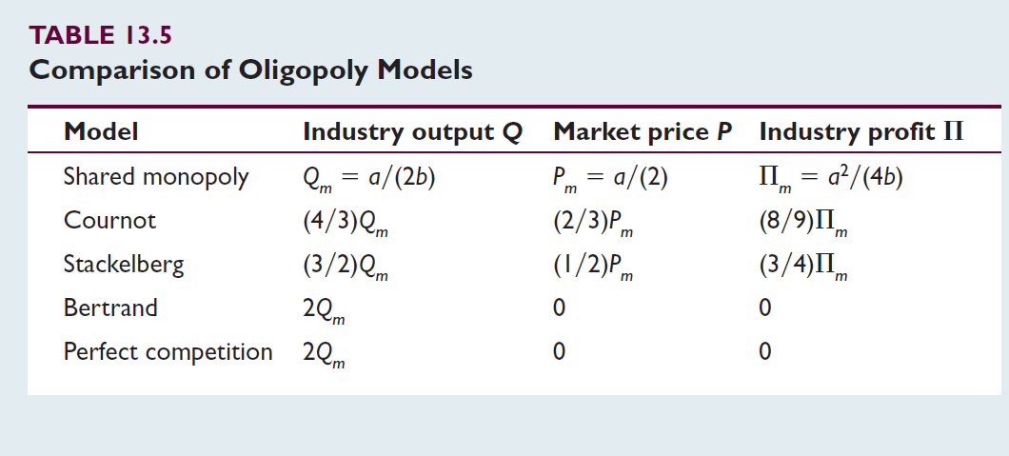
Comparison Of Outcomes
13-16

Slide 17
Figure 13.9: Comparing Equilibrium Price and Quantity
13-17

Slide 18
Figure 13.10: Sharing a Market with Increasing Returns to Scale
Outcome:
Live and let live?
Merge?
Price war?
Monopoly: regulation, or contestable market?
13-18

Slide 19
Competition When There Are Increasing
Returns To Scale
In markets for privately sold goods, buyers are often too numerous to organize themselves to act collectively.
It may still be possible for private agents to exercise market power on their behalf.
13-19

Slide 20
The Chamberlin Model
Assumptions:
  A clearly defined “industry group” of a large number of firms produce products that are close, but imperfect, substitutes for one another.
  Free entry and exit.
Implications:
  Because the products are imperfect substitutes, each firm faces downward-sloping demand.
  Each firm acts as if its own price and quantity choices have no effect on those of other firms.
13-20

Slide 21
Figure 13.11: The Monopolistic Competitor’s Two Demand Curves
13-21

Slide 22
Figure 13.12: Short-Run Equilibrium for the Chamberlinian Firm
13-22

Slide 23
Figure 13.13: Long-Run Equilibrium in the Chamberlin Model
13-23

Slide 24
Perfect Competition Versus Chamberlinian
Monopolistic Competition
Allocative efficiency
  Perfect: MB = P = MC
  Monopolistic: MB = P > MC
Cost efficiency
  Perfect: minimum LAC
  Monopolistic: above minimum LAC
Long-run profitability: both the same
Product variety
  Perfect: none
  Monopolistic: lots
13-24

Slide 25
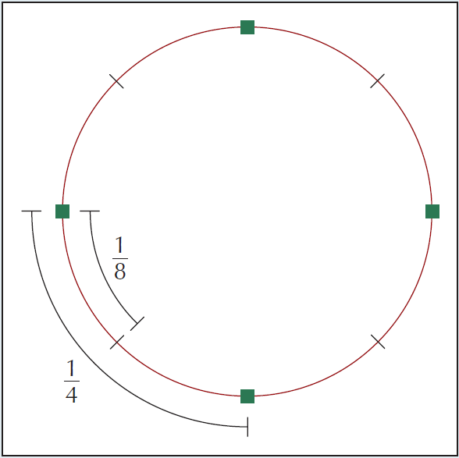
Figure 13.14: An Industry in Which Location is the Important Differentiating Feature
13-25

Slide 26
Circle Model of Spatial Competition
Assumptions
  Circle circumference, C=1
  Population, L, distributed uniformly
  Demand, 1 unit per consumer
  Consumer’s travel cost, t, per unit distance
  Firm’s production cost, TC = F + M Q
  Number of firms, N, each with same product
  Customers eat where cheapest
Analysis: calculate cost-minimizing N*, model equilibrium N, and compare
13-26

Slide 27
Figure 13.14: An Industry in Which Location is the Important Differentiating Feature
13-27

Slide 28
Figure 13.15: Distances with N Outlets
13-28

Slide 29
Figure 13.16: The Optimal Number of Outlets
13-29

Slide 30
Optimal and Equilibrium Number of Locations
How will the optimal number change in response to changing population density, transportation cost, or fixed cost?
The equilibrium number of outlets from profit-seeking choices varies more with several aspects of the model’s set-up.
Any environmental change that leads to a change in the optimal number of outlets changes the equilibrium number in the same direction.
13-30

Slide 31
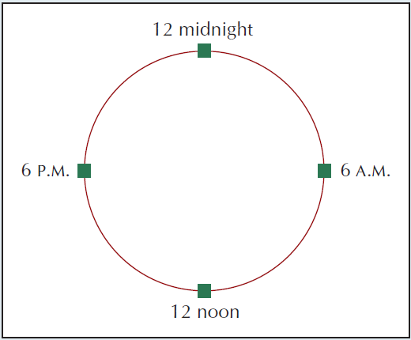
Figure 13.17: A Spatial Interpretation of Airline Scheduling
13-31

Slide 32


Figure 13.18: Distributing the Cost of Variety
(Shankar, 2011)
13-32
Notes:
References:
Shankar, V. (2011, October 12). Benchmarking of key global OEMs vehicle platform strategies. Frost & Sullivan. Retrieved from http://www.slideshare.net/FrostandSullivan/frost-sullivanbenchmarking-of-key-global-automotive-oemsoct2011.

Slide 33
Consumer Preferences And Advertising
Advertising initially increases demand for a differentiated product, because it can be
  Persuasive, altering consumer preferences
  Informative of choice from stable preferences
  Complementary to products
Which predominates? It varies. Evidence is mixed.
Fixed costs increase market concentration
13-33

Slide 34
Consumer Preferences And Advertising
Advertising is more persuasive for less familiar and more networked products.
If consumers have well-defined preferences and experience reveals product quality,
  Sellers have incentives to more heavily advertise higher quality products
  Advertising informs about quality: of product and brand
Do ads enhance your product experience?
13-34

