Slide 1
Comments about this as an example
The student presenters knew that the audience had seen the professor’s presentation about ecotourism’s potential benefits: internalizing some of what had been external benefits of private habitat conservation, etc. Hence they focused from the start on problems with realizing that potential.
The slides fairly effectively emphasize graphics that complement (rather than repeating) what they spoke about. Ecotourism is a relatively photogenic topic; other presentations could benefit from relatively more use of schematic diagrams, numerical charts, etc.
The spoken information was much more detailed than the text of the slides. It included a summary of their research questions and a thesis statement in the introduction, and many more and earlier references to concepts and theories than are shown in the slides.
You may follow their lead in separating the sources of graphics and other types of information into two reference lists, but it’s a rather artificial distinction, and one merged list is good.
Some entries in the reference lists aren’t quite in correct APA style, with a redundant entry of title and author (an organization), authors’ full first names, journal names not in italics, etc.
Although the font in the large statistical table is very small, at least the presenters used colored boxes to highlight the relevant parts.
See additional comments in the notes page for this slide. They’re partly redundant; I wrote them up separately and haven’t taken the time to integrate them here.
Notes:
Good things about this example of a presentation display include:
It emphasizing graphics more than text
It provides APA-style documentation of every source of information used that was not public knowledge or unique ideas of the presenters: cited where used and in the reference list, and with few errors. (It’s not necessary to separate out sources of images into a second list, but it is helpful to de-clutter the list of sources of other information.)
A brief outline on the second slide orients the audience to the organization of the rest of the presentation.
It demonstrates use of several types of graphics and figures: photos, maps, conceptual diagrams, data graphs, and a table of statistical results. (Although the table has a lot of numbers, the key results are highlighted visually. It would be even better if a pop-out graphic were animated to then display those numbers in a larger font.)
Its visual style is attractive but not obtrusive. (Preferably do not follow its example of animating slides with such distractingly varying movements.)

Slide 2
Ecotourism: Problems and Solutions in Botswana and Costa Rica
Resource and Environmental Economics
Name 1 and Name 2
April 27, 2014

Slide 3
Overview
Ecotourism definition
Problems with ecotourism
Economic
Social
Environmental
Solutions
Ecotourism certification
Others: government and industry actions
Conclusions

Slide 4
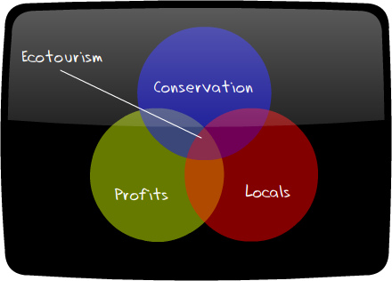
Ecotourism Definition
“responsible travel to natural areas, which conserves the environment and improves the welfare of local people” (CESD, 2012)
Economic
Social/Cultural
Environmental
(Scribol Travel, 2010)

Slide 5
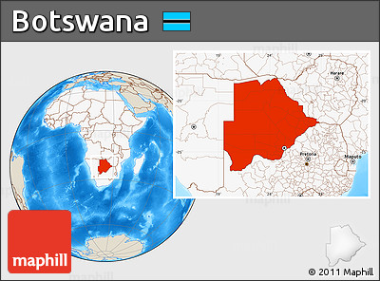
(Location Map of Botswana, 2011)

Slide 6
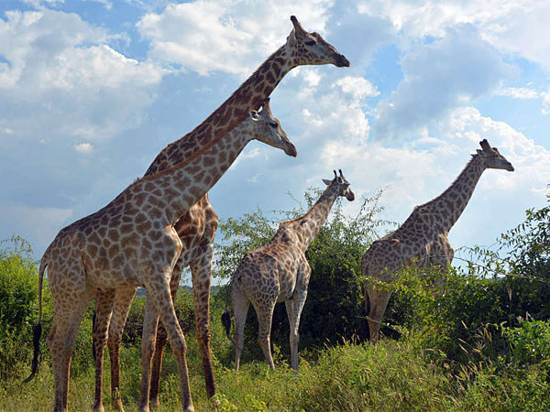
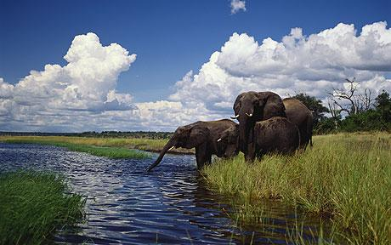
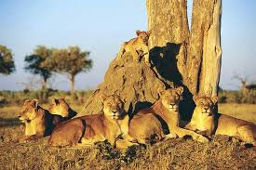
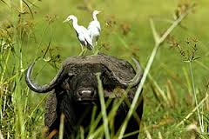
(Noronha, 2013)
(Starmer-Smith, 2010)
(Botswana Safari Packages, 2012)
(Botswana-Safari.net, 2001)

Slide 7
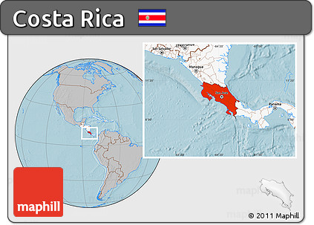
(Shaded Relief Location Map of Costa Rica, 2011)

Slide 8
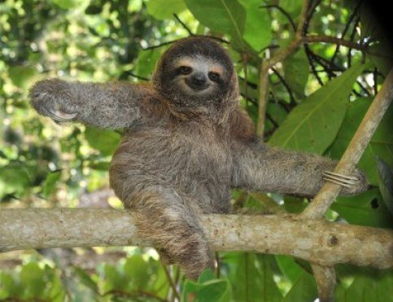
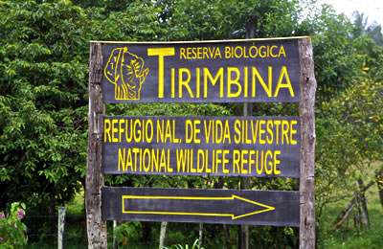
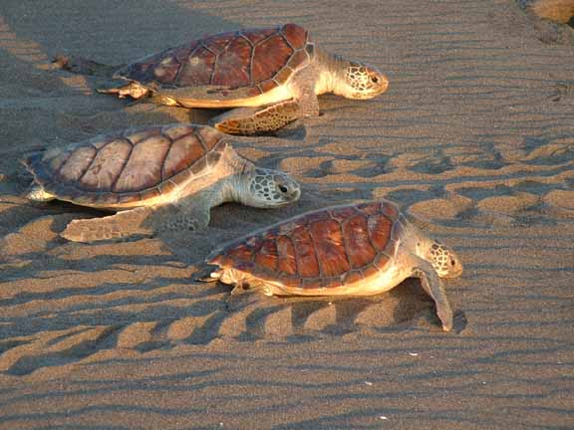
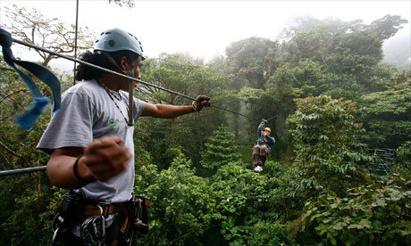
(lschwecherl, 2013)
(Costa Rican Bird Route 2010)
(Quesada, 2013)
(Alarmy, 2007)

Slide 9
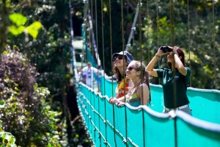
The Main Sources of Travelers to Costa Rica
Percentage of Total Number of Tourists
1. US 48.7%
2. Canada 5.3%
3. Colombia 4.8%
4. Mexico 4.1%
5. Spain 3.2%
6. Germany 2.9%
(Dasenbrock, 2002)
(Record Number of Tourists, 2014)

Slide 10
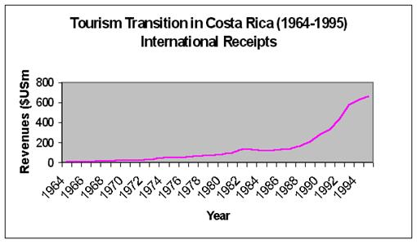
(Narayan,1998)

Slide 11
Problems: Economic
Botswana
70% of revenue repatriated outside of country (Mbaiwa, 2005)
11% of the industry pays taxes in Botswana (Mbaiwa, 2005)
81.5% of ownership and influence by expatriates (Mbaiwa, 2005)
Employment
Costa Rica
It is estimated that over 50% of tourism revenue is never seen in the destination country (LePree, 2009)

Slide 12
Problems: Social/Cultural
Botswana:
Loss of local autonomy (Mbaiwa, 2005)
Does not contribute to poverty alleviation (Mbaiwa, 2005)
Creates social stratification (Hitchcock, 1997)
Degrades cultural values and activities (Hitchcock, 1997)
Costa Rica:
“…ecotourism perpetuates historical economic inequalities and further disempowers local peoples” (Horton, 2009)
Externalities of foreigners in communities

Slide 13
Problems: Environmental
Botswana
Does not contribute to conservation (Gossling, 1999)
High tourism numbers (Mbaiwa, 2005)
Environmental externalities (Mbaiwa, 2005)
Costa Rica
Tourism puts additional pressure on the environment
Externalities of tourists in natural environments

Slide 14
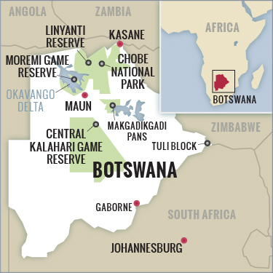
Solutions: Certifications – Botswana
Ecotourism certification system established in 2010
“Green” – lowest level
“Green+” – Middle level
“Eco” – Highest level
(Botswana Tourism Organization)
Level | Number
Eco | 16
Green+ | 3
Green | 1
No Award | 20
Award Pending | 6
Total Facilities Assessed | 45
(Boundless Journeys, 2014)

Slide 15
Solutions: Certifications – Costa Rica
Eco-certification Programs:
Blue Flag Program (BFP)
Certification for Sustainable Tourism (CST)
(Blackman et. al 2012)

Slide 16
(Rivera 2002)

Slide 17
Solutions: Others
Governmental actions:
Taxation
Increased tourist fees: park, visas, etc.
Regulations: environmental and tourism numbers
Local government involvement in regulations
Tourism industry initiatives:
Educating tourists and locals
Proportion of revenues for conservation fund and community public goods

Slide 18
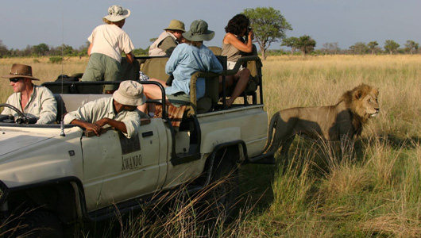
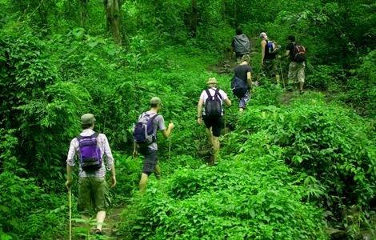
Conclusions
Ecotourism is relatively new
Case studies comparisons
With improvements ecotourism has the potential to be sustainable and beneficial economically, socially, and environmentally
(Lew, 2011)
(Hiking in Costa Rica, n.d.)

Slide 19
References
Blackman, A., Naranjo, M., Robalino, J., Alpízar, F., & Rivera, J. (2012). Does Tourism Eco-Certification Pay? Costa Rica’s Blue Flag Program. Resources for the Future. Retrieved from http://www.rff.org/RFF/Documents/RFF-DP-12-50.pdf
Botswana Tourism Organization. (2013). Botswana ecotourism certification system.
Center for Ecotourism and Sustainable Development. (2012). A simple user’s guide to certification for sustainable tourism and ecotourism (3rd ed.).
Coria, Jessica and Calfucura, Enrique (2011). Ecotourism and the development of indigenous communities: the good, the bad, and the ugly (Working papers in economics). University of Gothenburg.
Costa Rican Bird Route: Tirimbina Rainforest Center. (2010). Costa Rican Bird Route: Tirimbina Rainforest Center. Retrieved from http://www.costaricanbirdroute.com/sites/tirimbina.htm
Goodstein, E. & Polasky, S. (2014). Economics and the environment (7th ed.). Hoboken, NJ: Wiley.
Gossling, Stefan (1999). Ecotourism: a means to safeguard biodiversity and ecosystem functions?. Ecological Economics, 29, 303-320. Retrieved fromhttp://www.glerl.noaa.gov/seagrant/ClimateChange Whiteboard/Resources/Mac2/ee%20ecotourism%20biodiversity.pdf
Hitchcock, Robert K. (1997) Cultural, economic, and environmental impacts of tourism among Kalahari bushmen. In Erve Chambers (Ed.), Tourism and culture: an applied perspective (pp.93-128). Albany, United States: State University of New York Press.
lschwecherl. (2013, January 11). costa rica: the "plan". Camping Out In America. Retrieved April 27, 2014, from http://campingoutinamerica.com/2013/01/11/costa-rica-the-plan/
LePree, J. G. (2009). Certifying Sustainability: The Efficacy of Costa Rica’s Certification for Sustainable Tourism. Retrieved from Florida Atlantic Comparative Studies Journal website: http://home.fau.edu/peralta/web/FACS/certyfyingsustainability.pdf
Mbaiwa, Joseph E. (2005). The problem and prospects of sustainable tourism development in the Okavango Delta, Botswana. Journal of Sustainable Tourism, 13, 203-227. Retrieved from http://www.tandfonline.com/doi/abs/10.1080/01434630508668554.
Quesada, M. (2013, April 7). Costa Rica Jaguars Eating Sea Turtles. The Costa Rican Times. Retrieved April 23, 2014, from http://www.costaricantimes.com/costa-rica-jaguars-eating-sea-turtles/14134

Slide 20
References: Photos
Botswana-Safari.net (2010). Botswana-mammals. Retrieved from http://www.botswana-safari.net/botswana_mammals.html.
Botswana Safari Packages (2012). 7 Days Botswana national parks tour. Retrieved from http://www.botswanasafaripackages.com/botswana-safaris/7days-botswana-parks-tour.html.
Botswana Tours & Travel. (n.d.). Botswana Tours & Travel. Retrieved April 23, 2014, from http://www.adventure- life.com/botswana
Botswana Ultimate Custom Safari. (n.d.). Boundless Journeys.com. Retrieved April 25, 2014, from http://www.boundlessjourneys.com/africa/botswana-zambia/ultimate-private-safari/
Costa Rican Bird Route: Tirimbina Rainforest Center. (2010). Costa Rican Bird Route: Tirimbina Rainforest Center. Retrieved April 27, 2014, from http://www.costaricanbirdroute.com/sites/tirimbina.htm
Dasenbrock, J. (2002, January 1). "Take Nothing but Pictures, Leave Nothing but Footprints and Waste Nothing but Time". TED Case Study Template. Retrieved April 24, 2014, from http://www1.american.edu/ted/costa-rica-tourism.htm
lschwecherl. (2013, January 11). Costa Rica: the "plan". Camping Out In America. Retrieved April 27, 2014, from http://campingoutinamerica.com/2013/01/11/costa-rica-the-plan/
Narayan. (1998). A Closer Look: Ecotourism in Costa Rica. Retrieved April 25, 2014, from http://biology.duke.edu/bio217/2005/cmp8/costarica.html
Shades of green. (2007, May 26). The Guardian. Retrieved April 25, 2014, from http://www.theguardian.com/travel/2007/may/26/saturday.costarica
Record Number of Tourists in Costa Rica for 2013. (2014, January 16). The Costa Rican Times. Retrieved April 27, 2014, from http://www.costaricantimes.com/record-number-of-tourists-in-costa-rica-for-2013/24261
Lew, J. (2011, September 9). Can Eco-tourism help underdeveloped countries?. Mother Nature Network. Retrieved April 23, 2014, from http://www.mnn.com/lifestyle/eco-tourism/stories/can-eco-tourism-help-underdeveloped-countries
Noronha, Charmaine (2013). Botswana’s Okavango Delta’s got game. Retrieved from http://www.philly.com/philly/living/travel/20131117_Botswana_s_Okavango_Delta_s_got_game.html.
Six Senses Eco Symposium: The Importance of Ecotourism. (n.d.). Six Senses Eco Symposium: The Importance of Ecotourism. Retrieved April 25, 2014, from http://scribol.com/travel/six-senses-eco-symposium-the-importance-of-ecotourism
Starmer-Smith, C. (2007, July 31). Travel news in brief. The Telegraph. Retrieved April 23, 2014, from http://www.telegraph.co.uk/travel/7167141/Travel-news-in-brief.html
Quesada, M. (2013, April 7). Costa Rica Jaguars Eating Sea Turtles. The Costa Rican Times. Retrieved April 23, 2014, from http://www.costaricantimes.com/costa-rica-jaguars-eating-sea-turtles/14134

